Slide 1
A Light Rapid Transit ‘fit’ for
Leeds City Region
Presentation: Roger Harrison
Chairman: Tramlink Nottingham
2007 - 2015

Slide 2
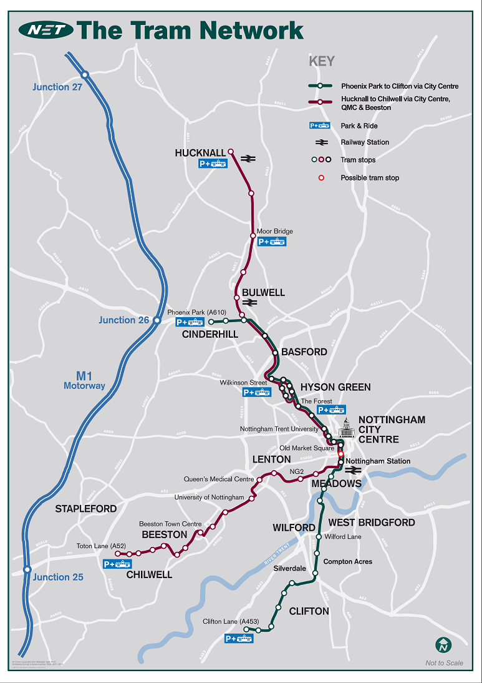
Nottingham Tram Network 2015

Slide 3
Passenger & Growth Demand in Leeds
Key Document: ‘Higgins’ Report on the proposed Yorkshire Hub
(Leeds) 2015
-forecasts +114% passenger demand increase over 30 yrs
Current demand c.29m pass/year (+114%= c.62m)
Leeds Station Footfall approx. 160-170m/yr
  -(retail/employment/travel & interchange…)
30 yr : Projected Footfall c.+250m/year
  -major retail development, leisure and employment opportunities linked into HS2 Leeds Station Masterplan
Station demand will be similar to Gatwick Airport which could not operate purely with bus access only

Slide 4
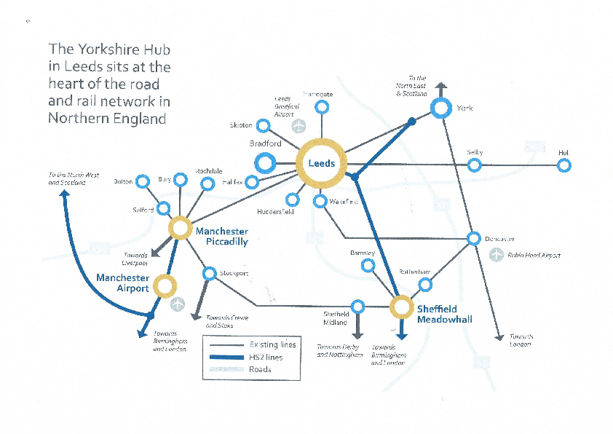
The ‘Yorkshire Hub’

Slide 5
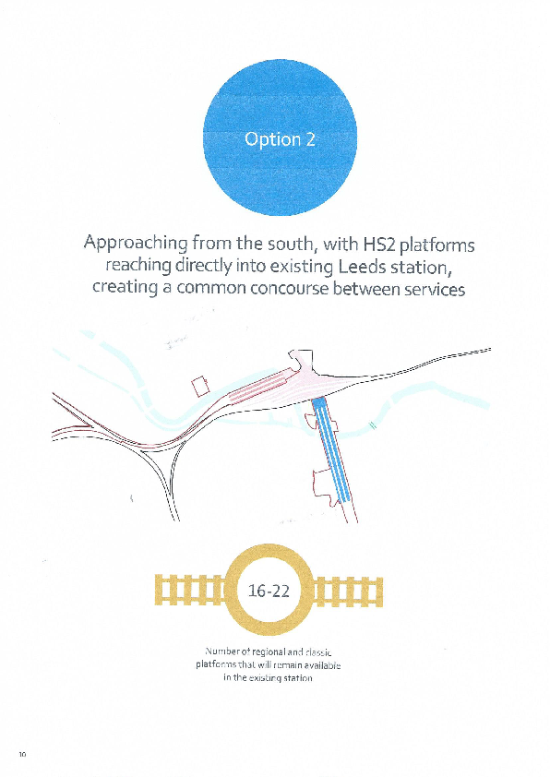
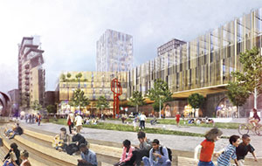
Leeds HS2 Station / Yorkshire Hub

Slide 6
Passenger & Growth Demand in Leeds
To cater for the current projected growth in demand would require twice as many buses in an already congested city – adding to levels of congestion, pollution and reduced attractiveness for inward investment.
Buses have an important role to play – recent announcement of £180m ‘overhaul of buses’ is good news for LCR but is only a part solution to the growing demand levels.
HS2 Business Case only really works with a step change in connectivity
- it needs to be a fully integrated station with good multi-modal connectivity
  - HS2 connectivity needs to include Bradford, Wakefield, Halifax, Huddersfield, Harrogate/York & LBA
- all other major UK cities along the HS2 routes have/aspire to fixed LRT connections plus bus and rail, why not Leeds?
£270m Transport Masterplan – recently announced is good news for the LCR but fails to fully address the Leeds Bradford Airport (LBA) required linkage, tram-train could provide that link allowing the LBA to compete operationally & commercially with other regional airports

Slide 7
Key LRT Benefits – Leeds
Maximizes HS2 Station ‘Business Case’
Environmental benefits – less pollution, reduces congestion, helps create regeneration of cities
More local jobs created, apprenticeships, local supply chain boost (Nottingham great example)
Improves the attractiveness of cities and attracts inward private investment
Recent technical developments helping to reduce scheme capital costs, more cities and areas looking at LRT (again)
Operating revenues exceed operating and maintenance costs once built

Slide 8
Types of LRT
Trams (eg Nottingham, Manchester, Sheffield, Birmingham, Croydon, Edinburgh)
Tram Trains – can operate on both tram lines and mainlines and operate interchangeably with heavy rail – Sheffield, Manchester
Light Metro (eg Tyne & Wear, LUL D stock refurb)
Ultra Light Rail (ULR) – Preston GUILD
Consider conversion of existing main lines or underused lines to LRT/metro operation – Cardiff Metro

Slide 9
Technical trends
Technical trends making LRT more attractive and affordable, supported by UKT and HMG in the UK and by manufacturer initiatives worldwide:
- lower cost modular track-form to reduce UD costs
- lower cost modular tramstops
- catenary free trams in city centres
- lighter weight rolling stock
- modern digital control systems
- modern integrated ticketing systems
- energy recovery/smarter power purchasing
- lower cost maintenance
- more standardisation

Slide 10
Costs and Build time
Some broad costs:
- Nottingham NET2 c.£30m/km (2015)
- Angers €30m/km (2010)
Trams generally approx. 10% scheme cost
  e.g. +/-£25m for an initial fleet 10 trams
8km starter tram line into/around Leeds centre, c.£250-£300m with P&R site near Stourton/M1 –M621, connecting
  Leeds Station/NPR/HS2 and;
  ‘new’ commercial, retail, leisure developments,
  and eventual link to Leeds-Harrogate line & LBA
  Conversion of Leeds-Harrogate-York line for tram train/tram conversion or metro

Slide 11
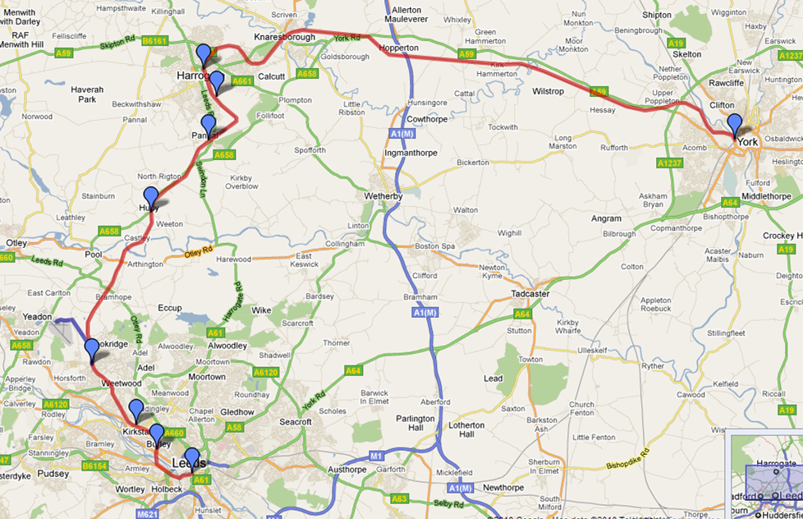
Leeds – Leeds Bradford Airport Link

Slide 12
Conclusions – Recap:
Leeds City Station is the busiest in the north of England
New rail franchises now deliver more services into Leeds
TransPennine Route Upgrade (2020) will add more demand/capacity (improvements between Leeds, Manchester, York)
Northern Powerhouse Rail improvements will further add to the capacity /demands into – through Leeds Station
HS2 by 2032 will provide connections to Birmingham to millions of new passengers

Slide 13
Conclusions
Leeds needs a rapid transit system
  to assist if nothing more than in taking out the potential high levels of congestion and demands on the public highway.
A new ‘starter tram line’ c.8km would assist in maximising the HS2 investment ‘Business Case’
Provides impetus to develop a regional LRT network
  with links fully to the LBA into the Leeds, Bradford and York city centres
Creation of thousands of jobs, provide the local supply chain with new businesses
Improve the attractiveness and environmental footprint of the region and encourage local inward investment

Slide 14
Conclusions
LRT needs to form part of an overall Transport Strategy to deliver the Leeds City Region Strategic Economic Plan (SEP)
  LEP Vision is for ‘good growth’
  Assist in giving the transformational change necessary to maximise the full benefits of HS2
LRT would unlock the great potential for Leeds to become a major player in the emerging Northern Powerhouse
LRT’s form the catalyst for development and regeneration in key destination hubs;
  Including the emerging South Bank

Slide 15
A Few Questions to consider
Challenges in delivery of tram / tram-train in Leeds?
What are the barriers and how does Leeds/WYCA overcome them?
Levels of Affordability and does a robust Business & Economic Case exist?
Impacts of tram-train on existing Leeds/Harrogate Line, both operationally and commercially?
Timescales (‘powers’ to deliver)?
Extent of segregation afforded to LRT?

